Slide 1

WNE UW
Applied/Advanced microeconomics – experimental and computational approach
Topic 3
Experimental economics
Notes:
1

Slide 2
Why experiemental economics?
Answer 1: There is a lot of fun to conduct experiments - for students and researchers.
„Taking a course in experimental economics is a little like going to dinner at a cannibal's house. Sometimes you will be the diner; sometimes you will be part of the dinner, sometimes both.”
(Bergstrom & Miller, Experiments with Economic Principles)
Answer 2: Economists desire doing science not pseudoscience

Slide 3
Why experiemental economics? The desire of doing science
Economics has been regarded as a non-experimental science, and you can find this type of thinking in old economic textbooks:
One possible way of figuring out economic laws ... is by controlled experiments. ... Economists (unfortunately )... cannot perform the controlled experiments of chemists or biologists because they cannot easily control other important factors. Like meteorologists, they generally must be content largely to observe.
(Samuelson and Nordhaus, 1985, p. 8)

Slide 4
Why experimental economics?
Economists create a model of reality and, based on logical inference (theory and models), obtain causal relationships between economic variables. Sometimes, we call these relationships laws - like in physics. In my opinion, there are no laws in economics - it is easy to find exceptions.
Econometrics is a set of tools to conclude whether this relationship is true or not. Researchers cannot control the environment of economic activities, and some factors are not included in the data sets. The quality of the data is still poor to test economic theory without any doubts. There is a lot of mistakes and fakes. (I will teach you how to test the fraud in a data set). Results -> we do nothing: Thousands of papers challenge the PPP (purchasing power parity) principle, and thousands of papers support it.
Economic Theory, through a formal deductive system, provides the basis for experimental abstraction and the experimental design, but society in most cases carries out the experiment, .... Therefore, the economic researcher observes the outcome of society’s experiment or performance but has little or no impact on the experimental design and the observations generated. Thus, by the passive nature of the data, economic researchers are, to a large extent, restricted in their knowledge search to the process of nonexperimental model building. ... the experiment is outside the researcher’s control. ( “The Nonexperimental Model-Building Restriction” in Judge et al. (1988))

Slide 5
Why experimental economics?
The desire for reproducing the research pattern of natural sciences is so strong that we sometimes fall into the cargo cult in which mathematics is treated an instrument of faith - the more math, the more scientific our work is.
[Richard Feynman on Pseudoscience https://www.youtube.com/watch?v=tWr39Q9vBgo]
The desire is evident not only in scientific articles. I was not surprised that book Zen and the Art of Motorcycle Maintenance by Robert M. Pirsig is the most influential non-scientific book for several Nobel prize winners in economics. It is my favourite book too – it presents the essence of the scientific method and its power. I recommend you to read a short fragment of the book [Moodle]
The desire for a new scientific method forced some economist to experiment. The beginning was a little bit anarchistic but very innovative.

Slide 6
Why experiments?
Thurston (1931) tested the indifference curve as a representation of preferences, later psychologists attacked rational choice paradigm
Expected utility theory was challenged by Allais (1953)‚ Savage(1954), Ellsberg(1961), Kahneman & Tversky (1979)
Chamberlin (1948), Smith (1968) tested market competitive equilibrium using induced values.
Nash and other mathematicians played games at the RAND seminars and at game theory lectures.

Slide 7
Why experiments?
Now, experimental economics is not a new niche area of economics. It is successful, fashionable and still a rising field. The success over the last 20 years was based on:
credibility as a science by developing very restrictive research procedures (especially laboratory experiments)
challenging the neoclassical microeconomic theory (as an infinite source of inspiration)
creating connections with psychology (love and hate relationship - inspiration and critics) [experimental economics ≠ behavioural economics ≠ economic psychology ]
applications i) the design and testing of new markets (energy and financial market) ii) design and testing new auction formats, ii) create marketing (sales strategies), ….,

Slide 8
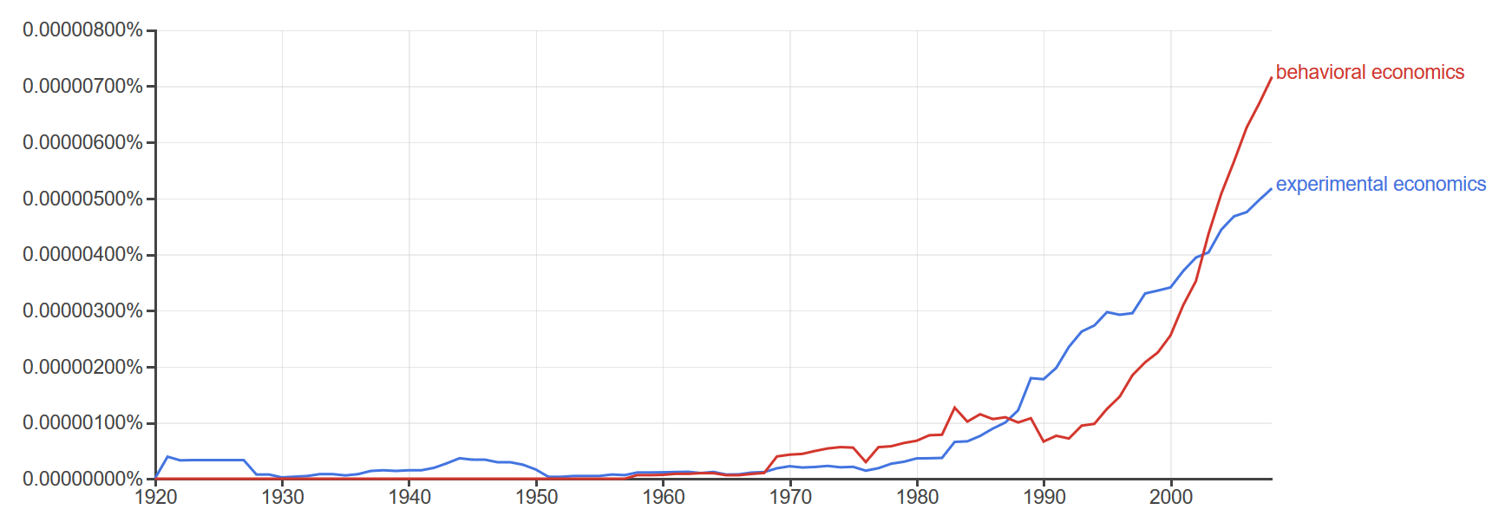
Why experiments?
Nobel Prizes for experimental/behavioural economists:
George Akerlof (2001)
Daniel Kahneman and Vernon Smith (2002)
Robert Shiller (2013)
Richard Thaler (2017)
Esther Duflo, Abhijit Banerjee, Michael Kremer (2019)

Slide 9
Why experiments?
There are different areas of applications of experimental economics and different types of experiments:
Applications of Economic Experiments
Testing economic theories (primery research)
Searching for unanticipated regularities which are not documented and not predicted by theory
Testing: institutions, economic policy tools and a new market design.
Researching preferences such as risk aversion, fairness, time discounting in different socio-demographical groups or in different situations
Replication of previous research and examination of the robustness of previous findings
Teaching by classroom experiments which are demonstrations of: i) the the experiemntal metodolgy ii) economic theory

Slide 10
Why experiments?
The classification of experiments can be carried out according to two criteria -> control of the experimental environment and the reflection of real economic processes. There is some tradeoff between these criteria.
Significant control is achieved during laboratory experiments. These experiments are poorly set in the real social context.
In natural experiments, control of the experimental conditions is low, but researchers have the opportunity to observe the participants in their natural environment. It is like an anthropological study.
Main types of economic experiments:
Conventional labolatory experiment. We can treat this type of experiment as a benchmark becouse it provides the best control conditions: abstract decision problem, homogeneity of subjects (students), avoiding some self-selection problems by randomization, setting communication rules and time restriction by using special lab and software,.....
Artefactual field experiment / as a laboratory experiment but conducted outside the laboratory on non - student subjects (large scale on-line experiments too).
Framed field experiment same as an artefactual field experiment, the context (frame) is related to real economic problems not abstract decision problem as in lab experiments.
Natural Field Experiment same as a framed field experiment but subjects do not know that they are in an experiment.
Natural and non-planned experiments; the big data includes the information about the results of big data experiments/ we have to find tools how to extract the results of the them. (my new category)

Slide 11
How conduct the experiments?
Conventional labolatory experiment.
The strict rules of creating laboratory design and protocol of the experiment are the most important factors affecting the creditability of experimental economics. Thanks to them, economic experiments are replicated in about 60%. For social sciences, this result is very good.
https://economics.stanford.edu/sites/default/files/eerp_sci_camerer_published_mainplussom_2016-1.pdf
The type of the experiment and application areas determine the design and protocol (plan) of the research. I will present some rules of experimental
(lab) methodology.

Slide 12
How conduct labolatory experiemnts?
How to conduct an experiments?
The subjects earn money. The monetary rewards depends on the actions of subjects. It is a simple and clear motivating factor.
The experiment should not be connected to real economic processes. The decision should be based only on pure analysis of the presented decision problem. References to real processes can disrupt the results. The level of knowledge about a real problem and the participant's attitudes towards the problem are difficult to control.
Experimenter should present full information about the conditions of the experiment and there is no place for cheating. Persons participating in the experiment should focus on the decision problem rather than on guessing the intention of the researcher.
The anonymity of the participant decision usually is guaranteed by the procedure of the experiment. The anonymity of payments is a rule.
.

Slide 13
How conduct the experiments?
Use scientific method ( read the Zen of …..!)
The experimenter should have a well-specified hypothesis
During the experiment, resercher should manipulate only one factor at once (treatment effect)
The design of the experiment should utilize randomization to estimate the treatment effect which has to be closely connected with the main hypothesis of the research.
But what is randomization? And why such a simple method is such a powerful research tool. Why it can be useful to you when you use econometrics or machine learning algorithms.
.

Slide 14
Randomization
The randomized experiment you know it from biology and medicine (testing a new drug). In the Randomized experiment ( the ideal one) :
Take a lot of subjects / the more diverse the population is the more subject we have to take
Randomly put them into two groups:
    - The treatment group in which we use a procedure(treatment) which we test (introduce a new drug)
    - The control group were the procedure is not applied(they receive a placebo or old drug)
  To ensure the robustness of results, the researcher can use the double-blind trial where neither subject nor the researchers know who is in the control group or in the treatment group.
The researcher collects data, analyses them during (after) the experiment. Observable differences in the outcomes ( health indicators) between the two groups can be used to conclude how the new procedure influences health. The inference can be based on differences in means between the two groups.

Slide 15
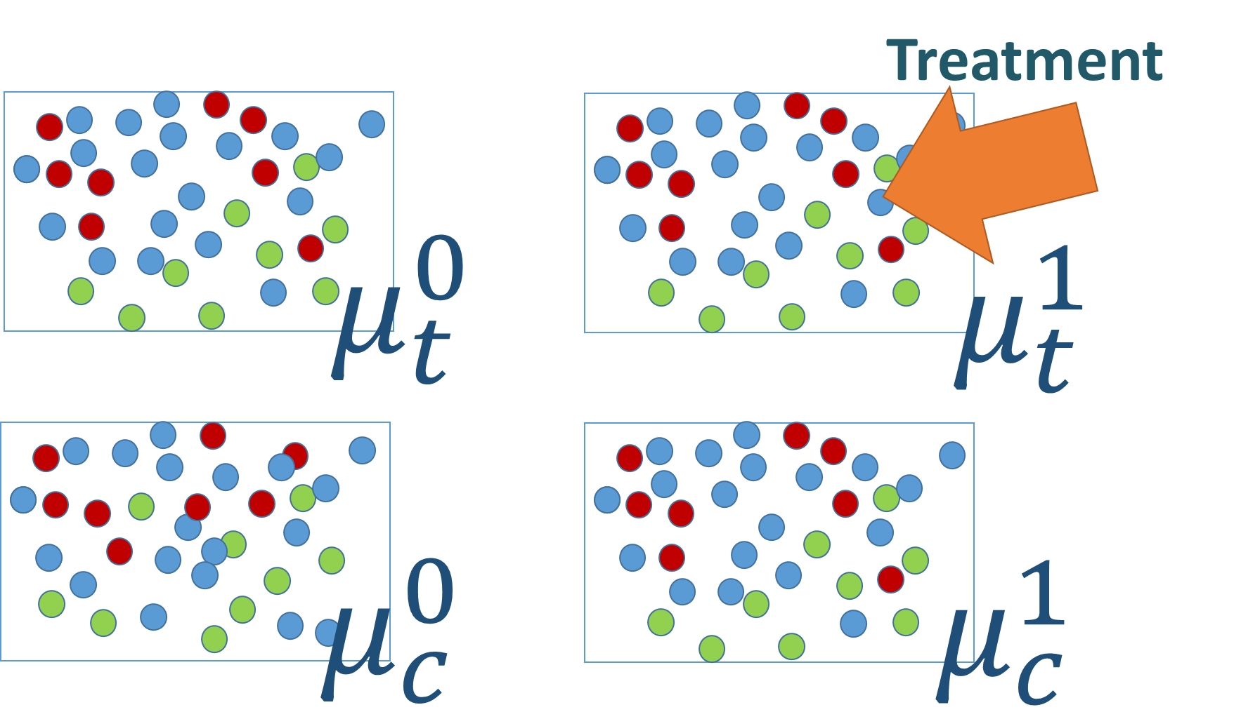
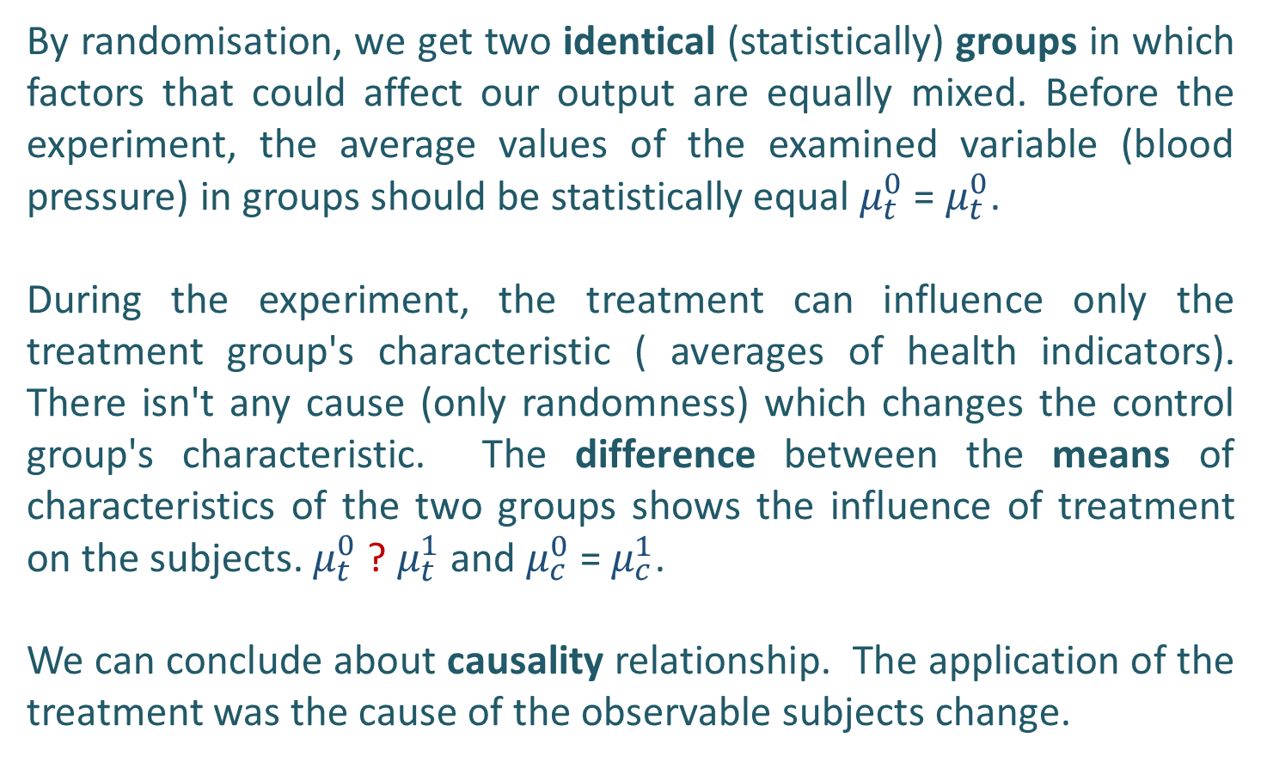
Randomization
By randomisation, we get two identical (statistically) groups in which factors that could affect our output are equally mixed. Before the experiment, the average values of the examined variable (blood pressure) in groups should be statistically equal $μ_{t}^{0}$ = $μ_{t}^{0}$.
During the experiment, the treatment can influence only the treatment group's characteristic ( averages of health indicators). There isn't any cause (only randomness) which changes the control group's characteristic. The difference between the means of characteristics of the two groups shows the influence of treatment on the subjects. $μ_{t}^{0}$ ? $μ_{t}^{1}$ and $μ_{c}^{0}$ = $μ_{c}^{1}$.
We can conclude about causality relationship. The application of the treatment was the cause of the observable subjects change.

Slide 16
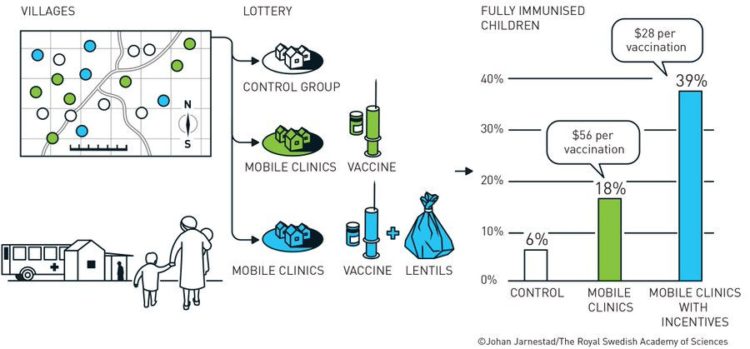
Randomization
Randomization can even be used in field experiments. Nobel prize winners (2019) have conducted this type of research in developing countries. For example, they studied how to motivate people to vaccination.

Slide 17
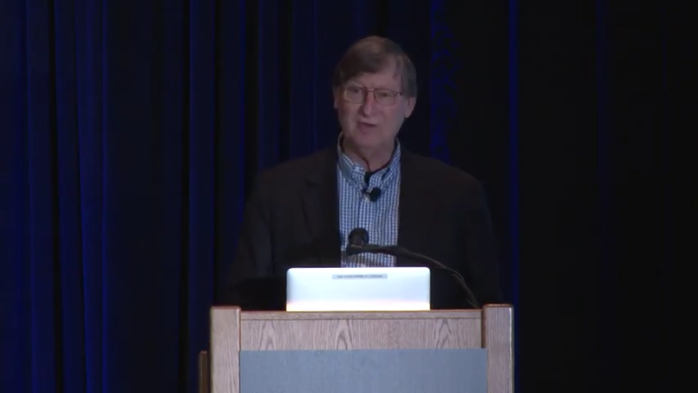
Watch this !!!!!!!!!!!
Natural and non-planned experiments; the big data includes information about their results/we have to find tools to extract the results of the experiments. (my new category)
Hal Varian (https://pubs.aeaweb.org/doi/pdf/10.1257%2Fjep.28.2.3)
https://www.youtube.com/watch?v=N89BnWUAAWU

Slide 18
Now it's time for the experiment
A very simple experiment.
A replication of the canonical study
Not based on randomization
A verification of economic theory.

Slide 19
Intro to consumer theory → The preferences
Rational choice theory makes some basic assumptions (axioms) about the preferences of homo economicus:
  Completeness - all alternatives can be ranked. If A and B are any two alternatives, an individual can always specify exactly one of these possibilities: i) A is preferred to B ii) B is preferred to A iii) A and B are indifferent
  Transitivity - if alternative A is preferred to B, and alternative B is preferred to C, then A is preferred to C.
  We can add some more axioms but they have technical implication not for the rationality
Together these assumptions ensure that preferences are consistent --> we can predict the behaviour of homo economicus.

Slide 20
The budget constraint
The consumers have finite resources.
We assume that consumers spend all their income (there are no savings in this model; if we want to allow for savings, we treat them as an additional variable).
Therefore, consumer spending can be represented by budget constraint of the form: p₁x₁ + p₂x₂ +…+ p_{n}x_{n} ≤ M.
The budget constraint is defined by the market: M and prices p1, p2 are given ... The external world defines his/her possibility of consumption.

Slide 21
Play with the model of consumer choice
The present model of consumer choice you will know better the model but let's play with the assumptions of the model. We will start with the simplest element - budget constraint and observable choices.

Slide 22
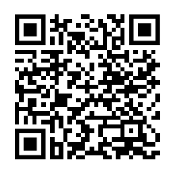
Results
Your results:
https://microeconomics.shinyapps.io/altruism_simulation/

Slide 23
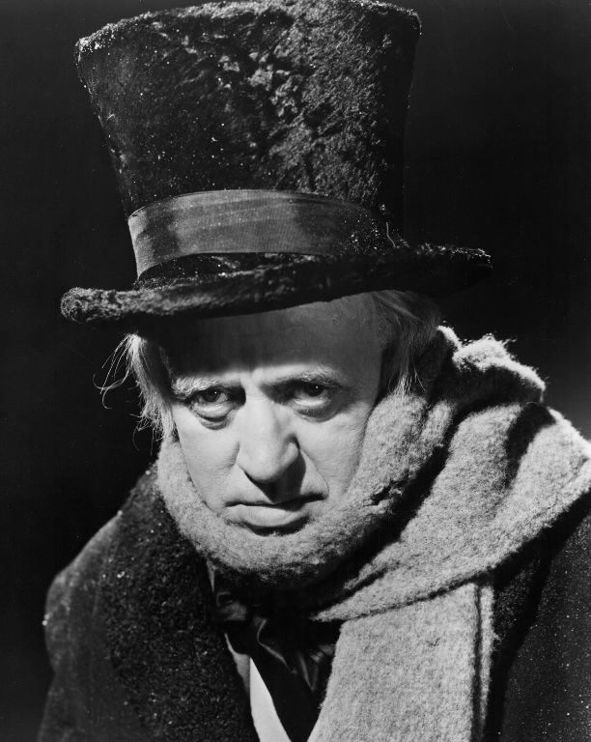
The storytelling
There is difficult to find a story about homo economicus as an abstract concept*. In microeconomic textbooks. By the lack of it, you create own vision of the economic man – own story. For you, homo economicus is Scrooge or even worse it is his caricature - Scrooge McDuck**
*,** The statements are based on text-mining analysis of microeconomic textbook and student comments on the forum.

Slide 24
The storytelling (ice cream n=250)
Term | n | Remarks
property | 245 | Propety rights are mentioned 86 times.
freedom | 2 | Personal freedom and proclaiming freedom are both mentioned one time.
institution (-s;-al) | 70 | Social institutions are mentioned five times; democratic institutions are mentioned one time. In the rest of the cases, the terms are applied to economic, financial, political, monetary, and market institutions. The terms institutional economics does not appear in any textbook.
(ir-) rational(-ity) | 152 | The phrase bounded rationality appears 2 times.
entrepreneur (-all; -ship) | 16 | The number of entries also includes the derivatives (such as entrepreneurial).
innovation (-tive;-ing) | 30 | The word most often appears in phrases such as global innovation, innovative programs, major innovation, reducing innovation.
invention (-or; -ing) | 16
knowledge | 44 | One of the most common phrases is technological knowledge. The phrase tacit knowledge does not appear in any textbook.
network (-s; -ing) | 195 | Social networks and social networking are mentioned six times together. In the rest of cases, the word appears in phrases such as computer network, network effect, network externalities, etc.
(im-) moral | 132 | Moral hazard appears 81 time; 9 times the term refers to judgment, codes, behavior, instincts, and philosophy.
society (-al.;-alizing;-alism;-ology) | 319 | Social norms are mentioned seven times. Social behavior is specified one time. The word socializing and phrase social environment, and social norms appear one time each.
ethics (-al) | 10 | The word appears in phrases, such as ethical judgments (2 times), ethically unacceptable (2 times), ethical principle (1 time).
altruism (-tic) | 1 | The word appears one time in the phrase altruistic desire.
homo economicus | 1

Slide 25
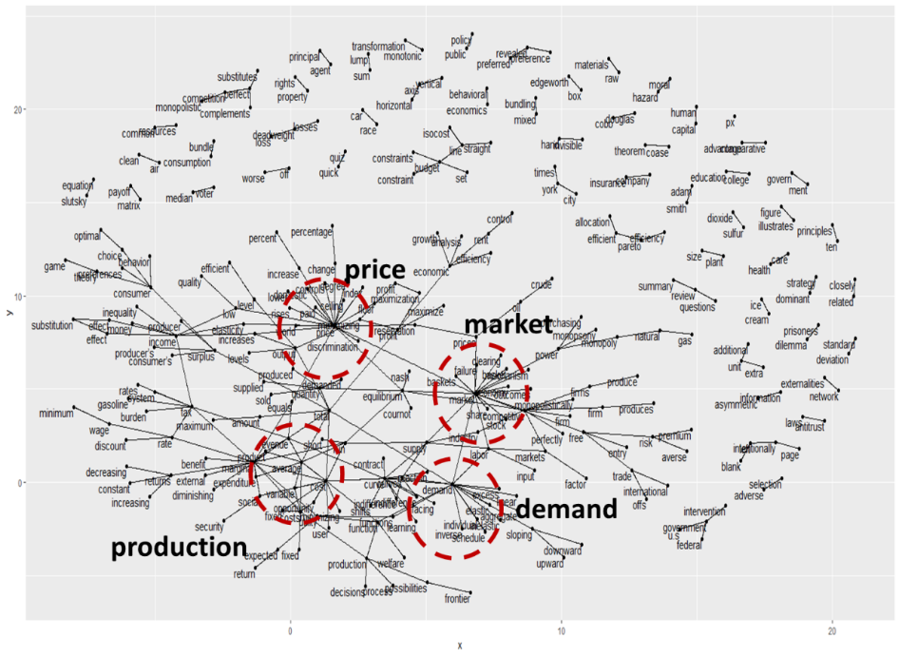
The storytelling

Slide 26
The storytelling
Economicsts have difficult to combine altruism and pro-social activities with the Homo economicus model. We do not know for sure how the narration influences economicst behaviour. There are many conflicting results of research which investigated the impact of economic education on student behaviour. But we can create own narration, which prevents the potential unwanted effects - such as the popularity of "Greed is OK" slogan.
The solution how to create the storytelling is in the definition of Homo economicus.

Slide 27
The storytelling
Levitt and List (2008):
...the discipline of economics is built on the shoulders of the mythical species Homo economicus. Unlike his uncle, Homo sapiens, H. economicus is unswervingly rational, utterly selfish, and can effortlessly solve even the most challenging optimization problems.
In the textbooks, rational behaviour is defined as consistent with the axioms of rational choice. Rational preferences should be complete and transitive.
The economic agent is characterised by self-regarding preferences* and thanks to this her/his decision-making can be interpreted as the process of maximising their utility, independent from the others’ utility. For Homo economicus, a good is everything he/she is willing to pay for: ice-cream, chocolate, as well as the drug, or the abstract good - such as altruism. *we need it for GE model

Slide 28
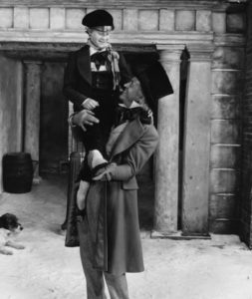
The storytelling
When we treat altruism as an economic good which we can put on consumer choice space then:
Egoist Scrooge (before his transformation) can be described by the homo economicus model.
Altruist Scrooge (after the transformation) can be described by the same model too.
The whole life of Scrooge is not rational because his preferences are not consistent - before the transformation, he preferred egoistic behaviours, after he preferred altruistic.
In the second case, he can have complete and transitive preferences - he can maximize his utility by consuming altruism as an economic good but his transformation changed society welfare.

Slide 29
Confrontation of the storytelling with the research findings
This experiment seems to be a good introduction to the Ultimate Game at the experimental economics lecture. But the Andreoni & Miller* approach gives us the opportunity to re-define choice space.
First step: at the beginning forget of game theory and treat the decisions as a simple consumer choice problem.
*Andreoni, J., & Miller, J. (2002). Giving according to GARP: An experimental test of the consistency of preferences for altruism. Econometrica, 70(2), 737-753.

Slide 30
Confrontation of the storytelling with the research findings
Introducing untypical budget constraints
Transforming the dilemmas presented in the experiment into the consumer’s choice problem can be a useful tool for:
Create abstract goods bundles
In microeconomic textbooks, there are almost no problems related to choosing between abstract goods. Instead, “real life problems” (ice cream versus chocolate, apples versus bananas, etc.) appear quite often.
Experience the consequences (real life problem)
You experience the immediate consequences of yourr decisions by combining the results of the experiment with the course score. It is a real-life dilemma related to the choice between abstract goods, such as altruism.

Slide 31
Confrontation of the storytelling with the research findings
Divide 40 tokens: Hold X at 1$ each, and Pass the rest of tokens at 3$ each
Initial endowment M = 40 tokens. Tokens can be any abstract resources such as time, skills. The value of this resource depends on who receives it.
v_{S} = 1 value of the unit "Payment to self" (how much is the token worth if I leave it to myself)
v_{O} = 3 value of the unit 'Payment to other' (how much is the token worth when it passes to another)
Reference to reality:
I devote my time to a colleague. I am preparing her/him for the exam. I have mastered the material better and for me, 1 hour's work is worth 3 hours of work for that person. By donating 1 hour of my time I save 3 hours for another person. Value of time can be estimated and convert to $.

Slide 32
Confrontation of the storytelling with the research findings
Divide 40 tokens: Hold X at 1$ each, and Pass the rest of tokens at 3$ each
Initial endowment M = 40 tokens → The relative price of one token for the player (ps) and opponent (po) is defined by the pass and hold values (1, 3)
Consider budget 1. Here transferring one token raises the other subject’s payoff by 1 point, and reduces one’s own payoff by 3, implying that the price of the opponent’s payoff is 1 and the price of self-payoff is 0.33. Hence, the token endowment is an income variable, the inverse of the hold value is the price of self-payoff ( S ) , and the inverse of the pass value is the price of other payoff (O).
  p_{S} = 0.33 - price for one unit „Payment to self”
  p_{O} = 1 - price for one unit „Payment to other”
Budget constraint: M = 0.33* Payment to self(S) + 1* Payment to other(O)
40 = 0.33*S + 1*O

Slide 33
Divide 40 tokens:
Hold X at 1 $ each, and Pass the rest of tokens at 3 $ each
  Choice
I give everything to another player → she/he will receive 40 tokens worth 3, so her/his income will be 120
Payment to other
120
40 = 1p_{S} + 1/3p_{O}
Intermediate combinations of token distribution are possible - I'll leave some for myself / I'll give some to someone else
I leave everything to myself --> I will have 40 tokens worth 1, so my income will be 40
40
Payment to self

Slide 34
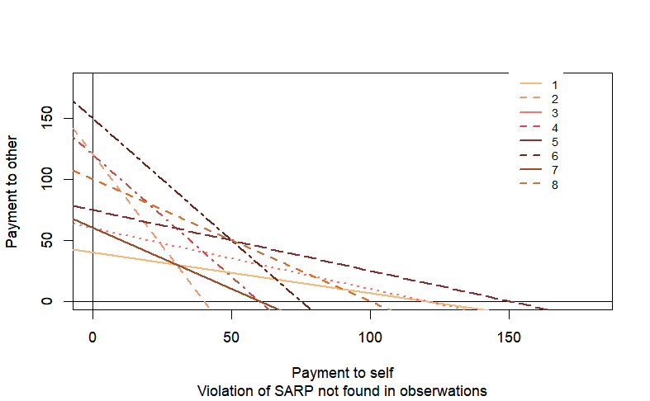
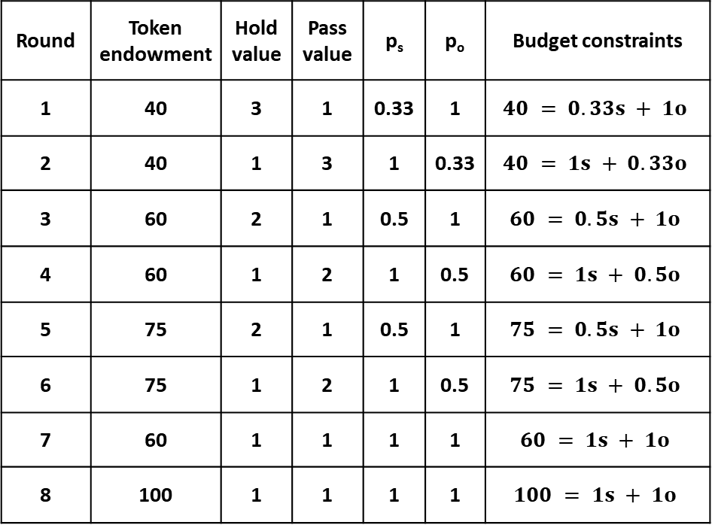
Confrontation of the storytelling with the research findings
Round | Token endowment | Hold value | Pass value | p_{s} | p_{o} | Budget constraints
1 | 40 | 3 | 1 | 0.33 | 1 | $$40 = 0.33s + 1o$$
2 | 40 | 1 | 3 | 1 | 0.33 | $$40 = 1s + 0.33o$$
3 | 60 | 2 | 1 | 0.5 | 1 | $$60 = 0.5s + 1o$$
4 | 60 | 1 | 2 | 1 | 0.5 | $$60 = 1s + 0.5o$$
5 | 75 | 2 | 1 | 0.5 | 1 | $$75 = 0.5s + 1o$$
6 | 75 | 1 | 2 | 1 | 0.5 | $$75 = 1s + 0.5o$$
7 | 60 | 1 | 1 | 1 | 1 | $$60 = 1s + 1o$$
8 | 100 | 1 | 1 | 1 | 1 | $$100 = 1s + 1o$$
Our choice between two goods: „Payment to self” (S) / „Payment to other” (O) is constrained by the
endowment of tokens and
ii) the prices / relative value of the two goods -> we can construct the budget constrain for each round.

Slide 35
Confrontation of the storytelling with the research findings
Testing „rationality”
We can test: Weak Axiom of Revealed Preference (WARP) and Strong Axiom of Revealed Preference (SARP). These tests indicate when our choices are inconsistent.
Axioms of rational choice:
A preference ordering is complete, and transitive.

Slide 36
Confrontation of the storytelling with the research findings
Rational choice
Payment to other
Bundle X was directly preferred to bundle Y
Directly Revealed Preferencies.
A bundle X is directly preferred to a bundle Y if Y was available when X was chosen.
X was chosen.
Y
Payment to self

Slide 37
Confrontation of the storytelling with the research findings
Weak Axiom of Revealed Preference (WARP): If bundle X is directly preferred to Y, then Y cannot be directly preferred to X.
X was chosen in rund 1
Z was chosen in rund 3
Y was chosen in rund 3
W was chosen in rund 1
In round 1, bundle X was chosen. Preferences were revealed but not in relation to Y (Y was not available).
In round 3, bundle Y was chosen. Preferences were revealed but not in relation to X. (X was not available)
Choices in rounds 1 and 3 did not violate WARP
In rund 1, bundle W was directly preferred to bundle Z. (Z was available)
In rund 3, bundle Z was directly preferred to bundle W. (W was available)
Choices in rounds 1 and 3 violated WARP - Non-rational behaviour

Slide 38
Confrontation of the storytelling with the research findings
Ilustration of indirectly preferences: when bundles A and B are available, bundle A is preferred over bundle B; when bundles B and C are available, bundle B is chosen. Therefore, one can conclude that A is indirectly preferred over C.
A was chosen in rund 1
B wasn’t chosen in rund 1 and was chosen in round 2
C wasn’t chosen in rund 2

Slide 39
Strong Axiom of Revealed Preference (SARP): If bundle A is directly or indirectly preferred to B, then A cannot be directly or indirectly preferred to B
X was chosen in rund 1
Y was chosen in rund 3
Indirectly revealed preferences [Rounds 1, 3]
X directly preferred to Y
Y directly preferred to Z
X is indirectly preferred to Z
Z directly preferred to X in Round 5
Z was not chosen in Round 1 and was not chosen in Round 3.
In Round 5, he was chosen.

Slide 40
Confrontation of the storytelling with the research findings
Testing WARP, SARP is quite difficult (especially on the basic course) but:
It is relatively easy to explain completeness and transitivity axioms and whether the particant's choices meet (or not) these assumptions
Understanding the algorithm procedures of the tests WARP, SARP themselves is quite difficult that even they rarely introduced at advanced courses. PhD of Varian ☺
We we can easily visualize choices that do not meet these assumptions using R_CRAN package ().

Slide 41
Confrontation of the storytelling with the research findings
Showing that altruism and rationality are not mutually exclusive
Based on data from ad hoc research we can show that there is no relationship between rationality (results of the test) and type of behaviour (altruistic or egoistic). We can show the individual data as well as pooled or even compare experimental groups.
Is altruism rational?
Yes - if we are consistent in our choices.

Slide 42
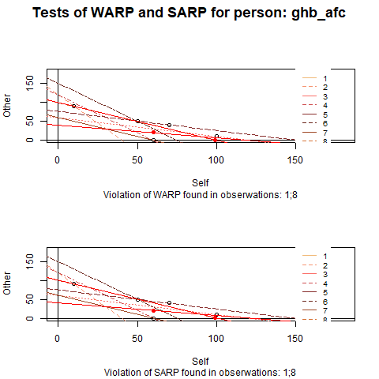
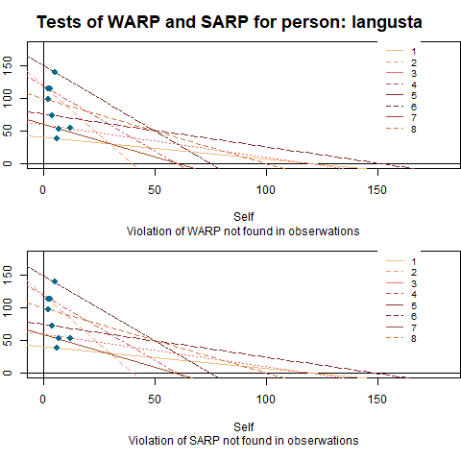
Confrontation of the storytelling with the research findings
Checking WARP and SARP ….. example of irrational egoist (marked in red) and rational altruist (from animation)

Slide 43
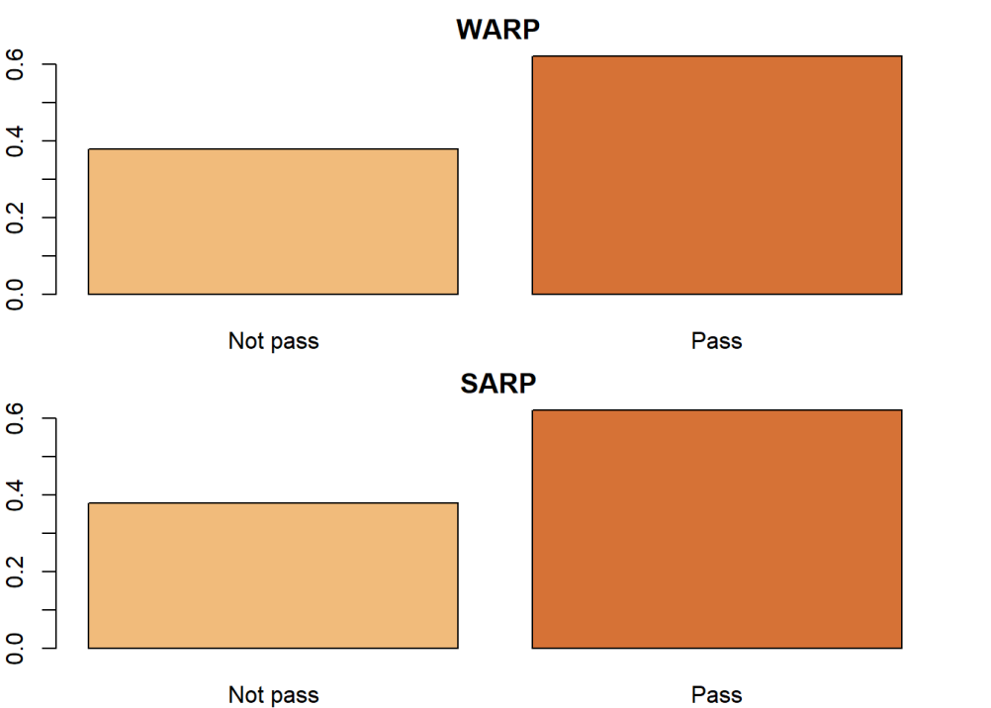
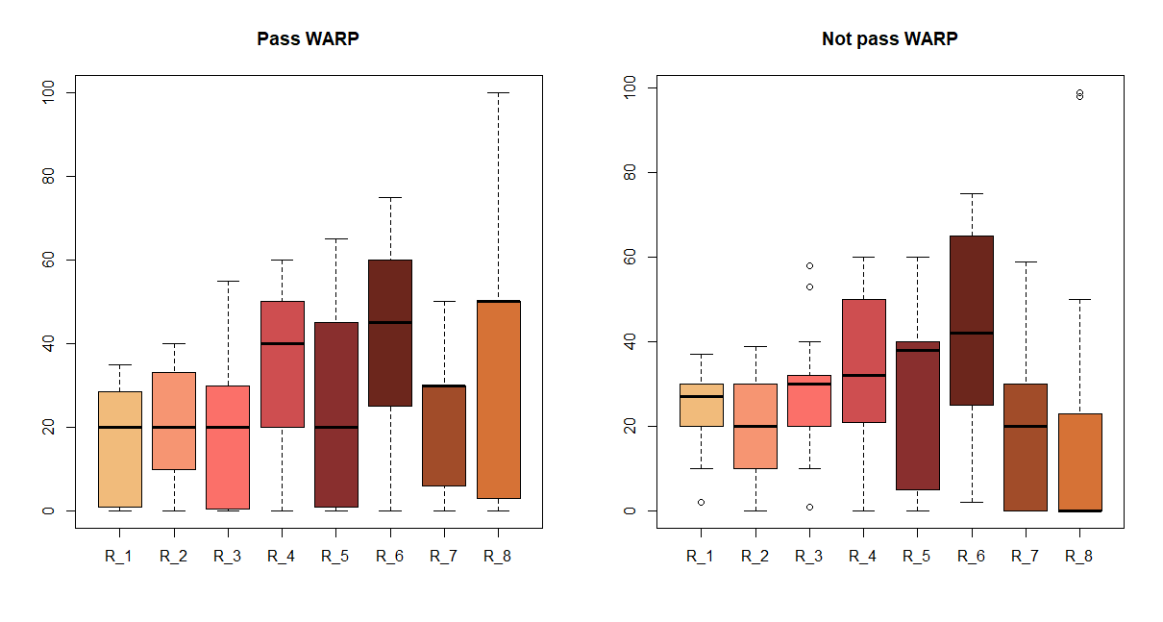
Confrontation of the storytelling with the research findings
Choices of more than 60% of students are consistent and pass the WARP, SARP tests.
There is no difference (on average) of passed tokens for "rational" and "non-rational" students.

Slide 44
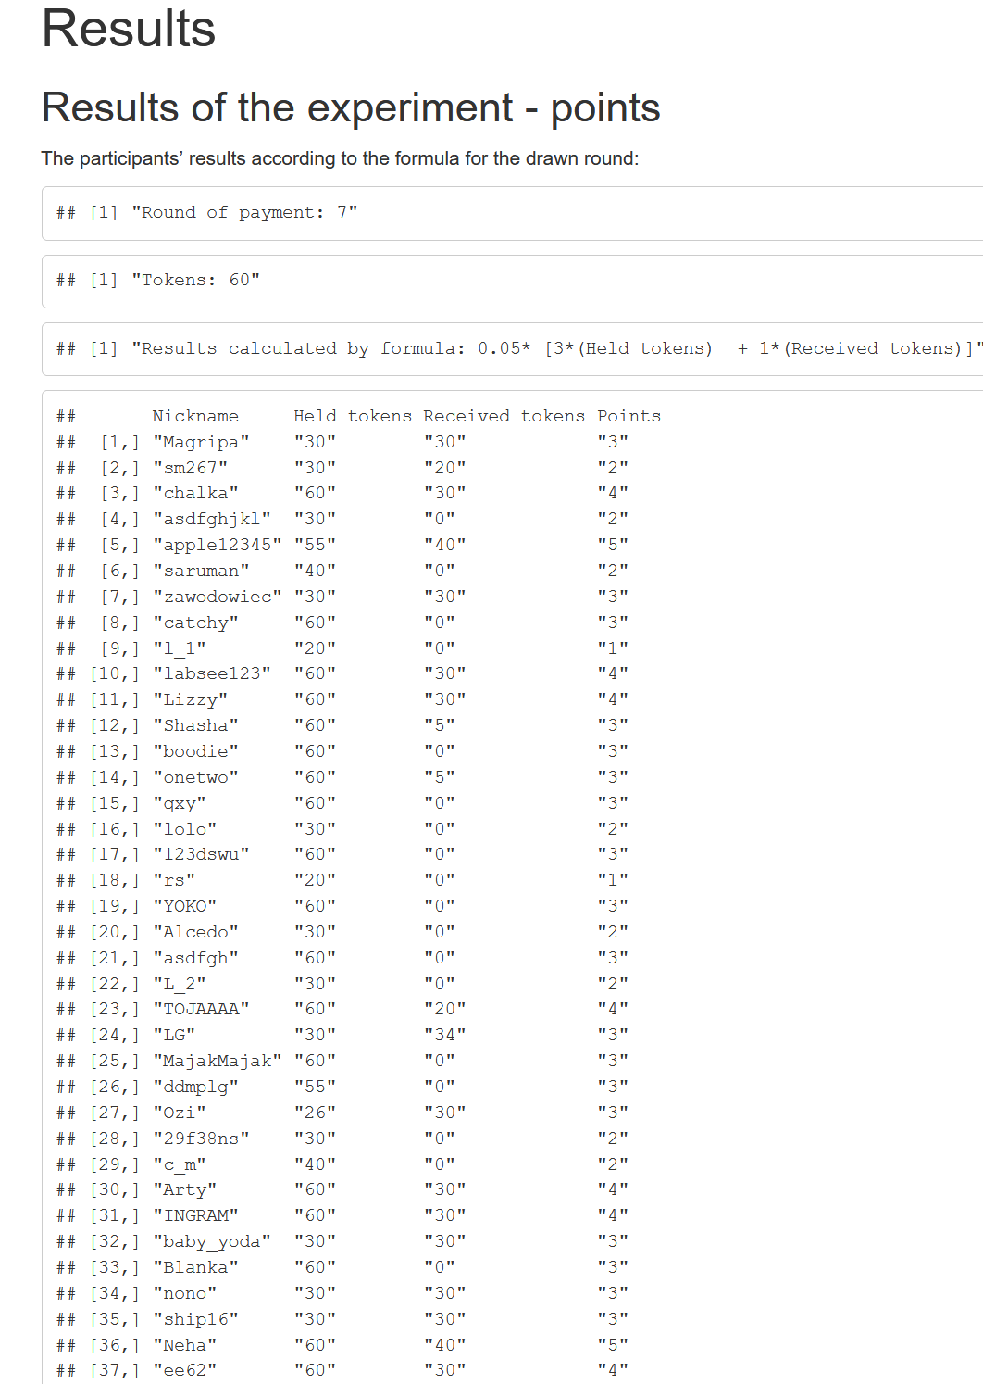
Your results
In the Test_GARP_s project folder, you can find your results and the beginning of the experiment analysis. You can discuss these results and develop this analysis in the forum.

Slide 45
Asking ethical questions
Now we will look at the results of the experiment from the point of view of the whole society (experimental group) and we will combine all the rounds. Is there any social norm that will make our society as wellbeing as possible?
Ethics and morality can be understood as a set of rules, according to which we should act. The results of the experiment can be used to consider ethical dilemmas using the simplified philosophical experiment.
The subjects of these discussions are two types of moral duty arising from two different approaches to ethics: deontological altruism and teleological (consequential) altruism.

Slide 46
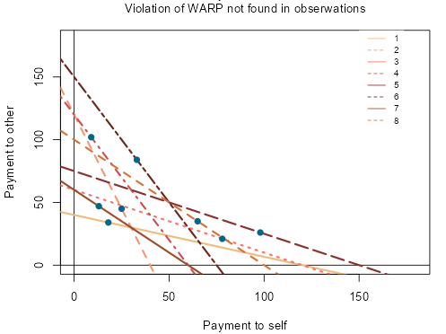
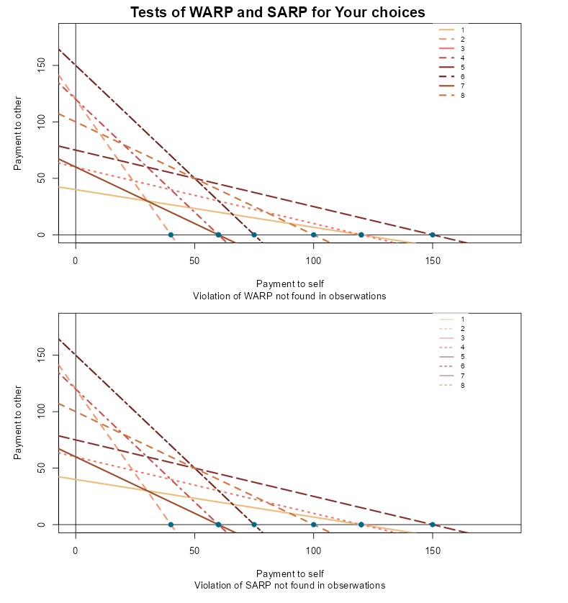
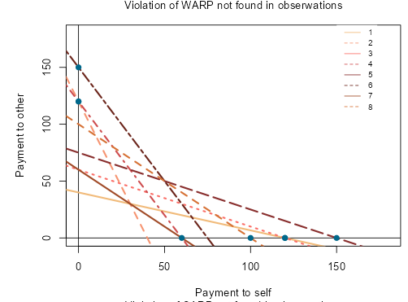
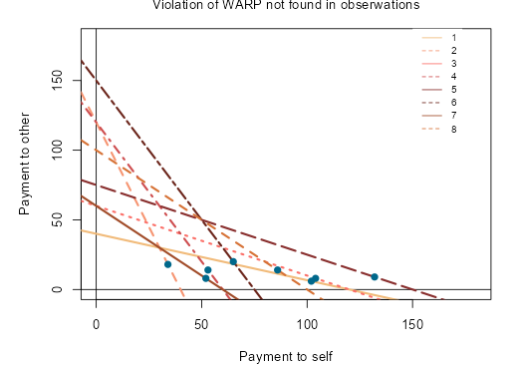
Your choices → Ethical attitudes
I don't give anything (~10%) Economics students after game theory :/
Random selections ~60%
Duty - I must always give (~10%) - deontological altruism.
Gives where there is the greatest benefit to society (<5%) - consequentialist altruism

Slide 47
Asking ethical questions
Deontological altruism – create moral duty
Let's assume that altruism is a “good” side of human nature. It is difficult to deny that charity, blood donation, and sharing the wealth with others without expecting any reward are morally desirable actions. We should not be selfish, as such behaviour ruins fundamental human values. Therefore, it is possible to formulate a moral duty arising from the belief that the principle of not being selfish is good by itself; such a moral duty can be referred to as deontological altruism.
Altruism is good in itself and we should always be altruist. And we have a duty to pass some tokens every round.

Slide 48
Asking ethical questions
Deontological altruism – trap
Round 2
Divide 40 tokens: Hold X at 1 $ each, and Pass the rest of tokens at 3 $ each
The ethical duty to donate several tokens is beneficial for the whole group and for each individual person in the group. For example, each student passes 10 tokens worth $1 and received 10 tokens worth $3 tokens.
Round 2
Divide 40 tokens: Hold X at 3 $ each, and Pass the rest of tokens at 1$ each
If players follow their moral obligation to transfer ten tokens, each of them gives away 10 tokens worth $3, in return they receive 10 tokens worth only $1. Everyone lost, and the deontological duty turns out to be a trap. This is an illustration of pathological altruism - “when altruism hurts the altruist” (Oakley, 2011)

Slide 49
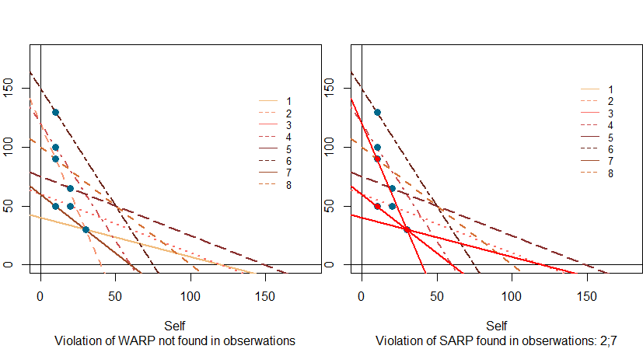
Asking ethical questions
Deontological altruism – inconsistency

Slide 50
Step 3 Asking ethical questions
Consequentialist altruism
Principles of consequentialist ethics are based on the consequences of our choices not on universal obligations. We can point two similar approaches to altruism which are based on utilitarian ethics - in which we are going to maximizing the utility/welth of the whole society.
Intelligent altruism the tendency to depend on suggestions, recommendation, persuasion, and information obtained through social channels as a major basis of choice (Simon, 1993).
Efficient altruism - to act in a way that brings about the greatest positive impact, based upon their values. (Singer)

Slide 51
Asking ethical questions
Intelligent altruism / efficient altruism principle
Round 1
Divide 40 tokens: Hold X at 3$ each, and Pass the rest of tokens at 1$ each
Effective altruism: we should take actions that will increase social well-being (the sum of all incomes) An ethical obligation to hold all tokens. Everyone kept 40 tokens worth $3 (and received nothing). From the point of view of social well-being, this is effective behaviour.
Round 2
Divide 40 tokens: Hold X at 1$ each, and Pass the rest of tokens at 3 $ each
An ethical obligation to hold all tokens. Everyone kept 40 tokens worth $3 (and received nothing). From the point of view of social well-being, this is effective behaviour.
The ethical obligation to pass all tokens. Each gave 40 tokens worth $ 1 and received 40 tokens worth $ 3. From the point of view of social well-being, this is effective behaviour, but ...

Slide 52
Asking ethical questions
Intelligent altruism / efficient altruism and rationality
Acting in line with intelligent altruism may suggest an inconsistency of choices. In rounds 1, 3 and 5 no tokens should be passed (selfish behaviour). In rounds 7 and 8 passing, any number of tokens does not change a situation, not motivating for sharing as well. In rounds 2, 4 and 6 all the tokens should be passed, which can be qualified as altruism. The intuition behind the consistency of choices can be misleading. Making decisions in line with the principles of intelligent altruism is rational and consistent with WARP and SARP. Altruism and selfishness are perfect substitutes: the agent should choose an option maximising the utility of the group subject to the given budget constraint.

Slide 53
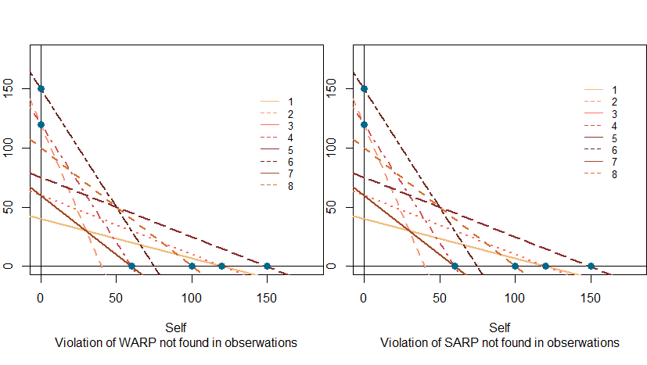
Step 3 Asking ethical questions
Intelligent altruism / efficient altruism and rationality

Slide 54
Asking ethical questions
Intelligent altruism / efficient altruism trap
The best agent strategy is pass nothing.
Round 2
Divide 40 tokens: Hold X at 1 $ each, and Pass the rest of tokens at 3 $ each
 | Pass all tokens | Pass 0 tokens
Pass all tokens | 120 120 | 0 160
Pass 0 tokens | 160 0 | 40 40
Social optimum -> Social Wealth = 240
Nash EQ-> Social Wealth = 80

Slide 55
Step 3 Asking ethical questions
Intelligent altruism / efficient altruism trap*
Intelligent altruism is optimal for every agent, but only under the condition, all the group members recognize and respect this duty. The situation, in which only one person decides to pass all the tokens in the second round, and the rest of the participants act perfectly selfish, is desirable from the standpoint of utilitarianism as a good one. The fact that this person has no income does not matter: passing 40 tokens still increases social utility by 80$. However, the utility of the only altruistic person will be zero.
* modification of Michael Sandel's argument against utilitarianism (gladiator in the Roman circus) http://www.coursehero.org/lecture/how-much-life-worth

Slide 56
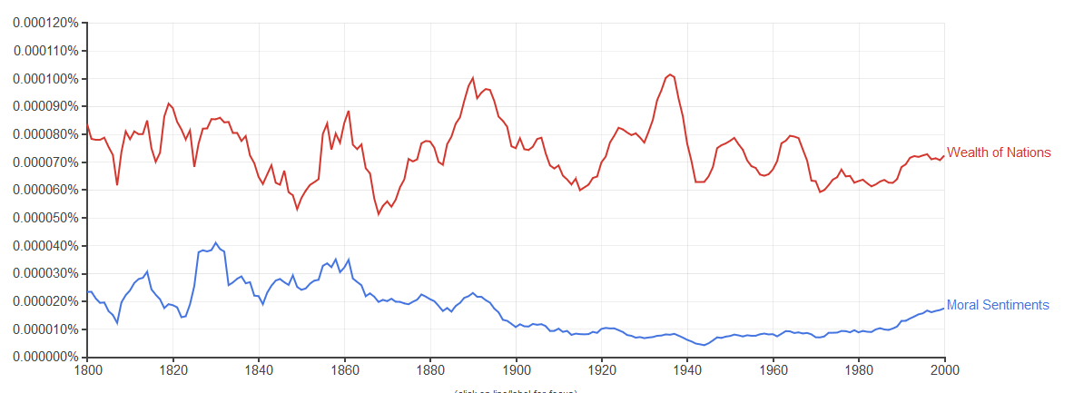
Asking ethical questions
Intelligent altruism / efficient altruism trap solution
In order to make sure that consequentialist altruism is not only beneficial for the group, but also does not hurt single economic agents, other moral duties and/or social norms should be introduced which prevent the situation described above. A. Smith (1761) recognised the existence of sympathy, stating that no human beings enjoy the sufferings of others. We need to include Moral Sentiment into economics. (V. Smith, 2019)
https://books.google.com/ngrams/

Slide 57
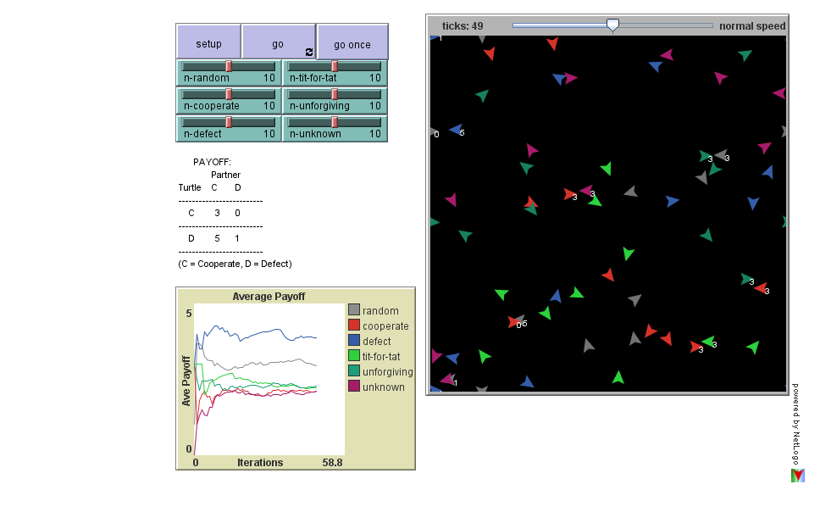
Asking ethical questions
Wait - It is time for evolution? We have to have time to learn what is the best for society.
Simulation Agent Based Economic – Iterated PD
Strategies:
RANDOM - randomly cooperate or defect
COOPERATE - always cooperate
DEFECT - always defect
TIT-FOR-TAT - If an opponent cooperates on this interaction cooperate on the next interaction with them. If an opponent defects on this interaction, defect on the next interaction with them. Initially cooperate
UNFORGIVING - Cooperate until an opponent defects once, then always defect in each interaction with them.
Change the structure of society
Watch:
https://www.youtube.com/watch?v=mScpHTIi-kM
http://ccl.northwestern.edu/netlogo/models/run.cgi?PDN-PersonIterated.759.578

Slide 58
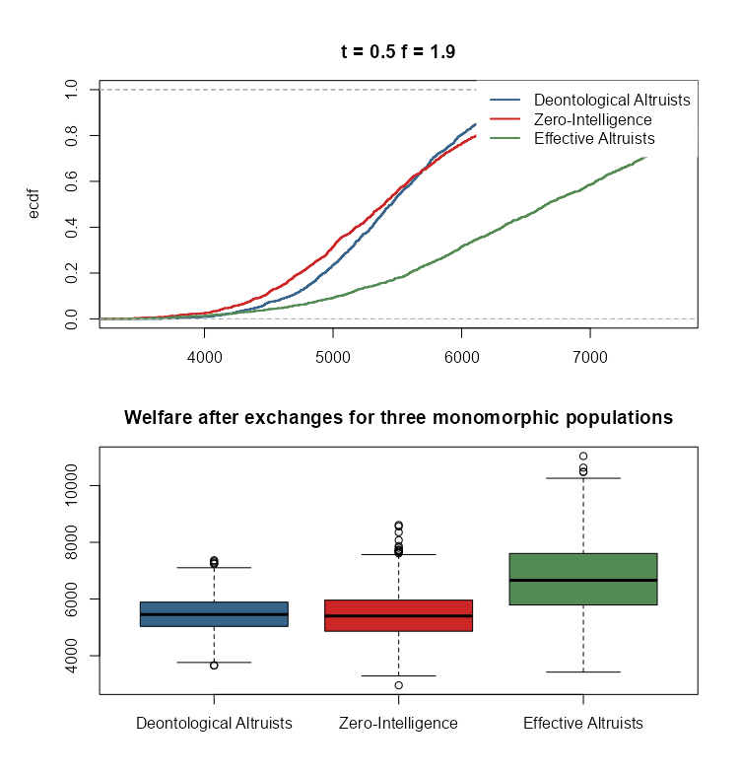
Simulation of a monomorphic society (all governed by the same rule)
N - rounds (as many as real-life events)
K1 - ZI agents (red society)
K2 - deontological altruistic agents (blue society)
K3 - effective altruistic agents (green society)
K1 = K2 = K3
In each round, everyone has a different budget constraint, i.e., income M [10,100] and different values:
vS [1,9] value of the "Payment to Self" unit (how much the token is worth if I keep it for myself)
vO [1,9] value of the "Payment to Other" unit (how much the token is worth if I give it to another)
The deontological agent determines the percentage of tokens to give to others (parameter t)
The effective agent determines how much the value of vo should be higher to be willing to give tokens to others (parameter f)
Each simulation run repeated B times
Kopczewski, T., & Okhrimenko, I. (2024). The paradox of effective altruism. Journal of Institutional Economics, 20, e41
Kopczewski, T., & Okhrimenko, I. (2019). Can homo economicus be an altruist? A classroom experimental method. International Review of Economics Education, 32, 100167.

Slide 59
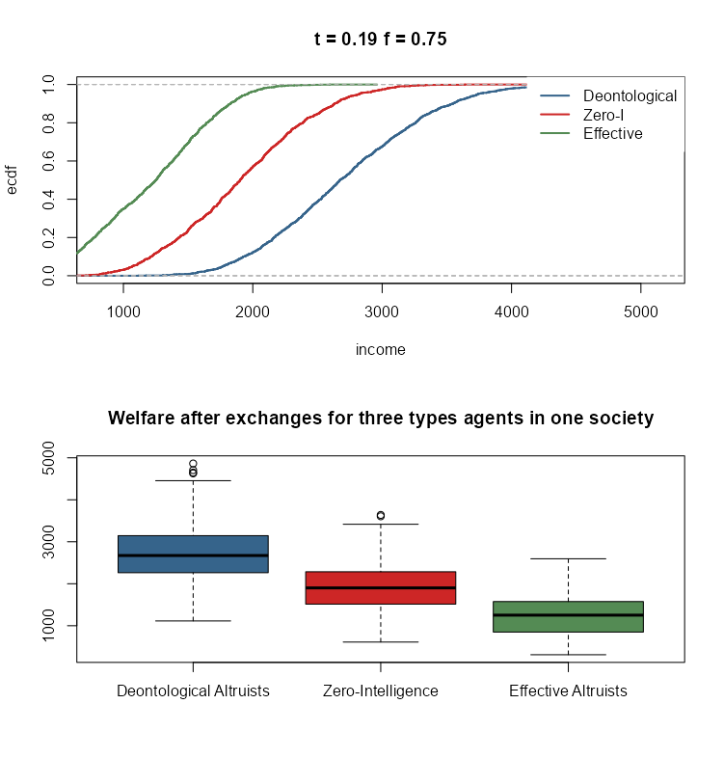
Simulation of a polymorphic society (three groups each following their own rules)
  N - rounds (as many as life events)
  K1 - ZI agents (red community)
  K2 - deontological altruistic agents (blue community)
  K3 - efficient altruistic agents (green community)
  K1 = K2 = K3
In each round, everyone has a different budget constraint, i.e., income M [10,100] and different values:
vS [1,9] value of the "Payment to self" unit (how much the token is worth if I keep it for myself)
vO [1,9] value of the "Payment to other" unit (how much the token is worth if I give it to another)
The deontological agent determines the percentage of tokens to give to others (parameter t)
The efficient agent determines how much the value of vo should be higher to be willing to give tokens to others (parameter f)
Each simulation run is repeated B times

Slide 60
Remarks about the methodology of experimental/observable research one remark about ethics
The causal inference
P-value cult
Large „natural” experiments

Slide 61
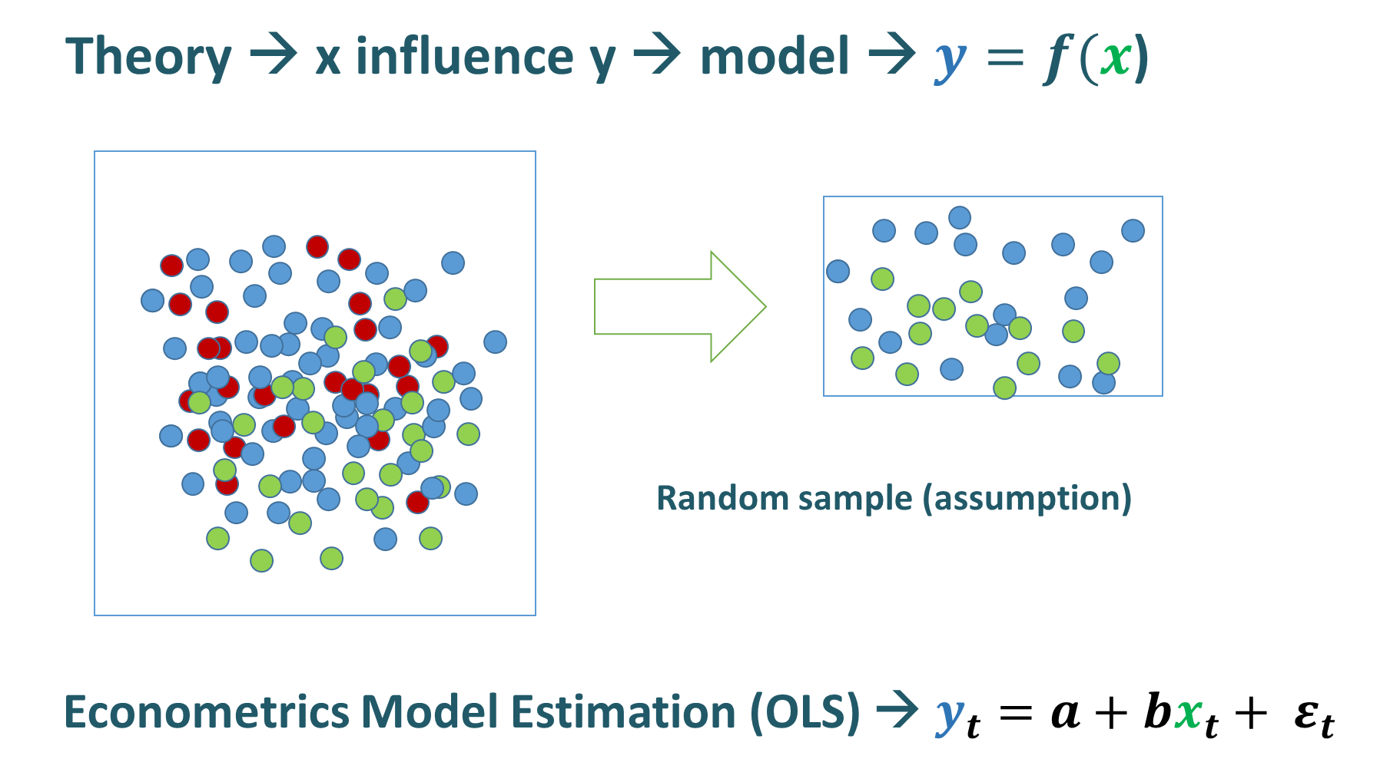
The causal inference
econometrics and causality
Randomization is a very simple method compared to econometric modelling. Unfortunately, any econometric models (based on sample data) cannot be treated as an explicit test of causal relations in the economy. Problems are i) biased and incomplete data set ii) the quality/reality of the theoretical model.
We create causal relationships in the theoretical model and we test the model. But the poor quality of the data hides the true relationship. Sometimes variables are influenced by the same hidden factor which is not included in the data. Sometimes there is pure coincidence.

Slide 62
The causal inference
econometrics and causality
Variables are sometimes associated but not causally related, due to the presence of unseen (hidden) common response variable - which influences both the dependent variable and independent variable.
The econometric model in which payment of compensation for property damaged in a fire is explained by a number of firemen extinguishing the fire seems OK [using standards econometric procedures: p-value, R²,… ]. But the model has no sense at all. Argumentum ad absurdum: an insurance company should push to fire firemen from job to lower the compensations. :) Here the common response variable is the size of the fire.
In time-series data there is a good simulation presenting the problem of the common response variable.

Slide 63
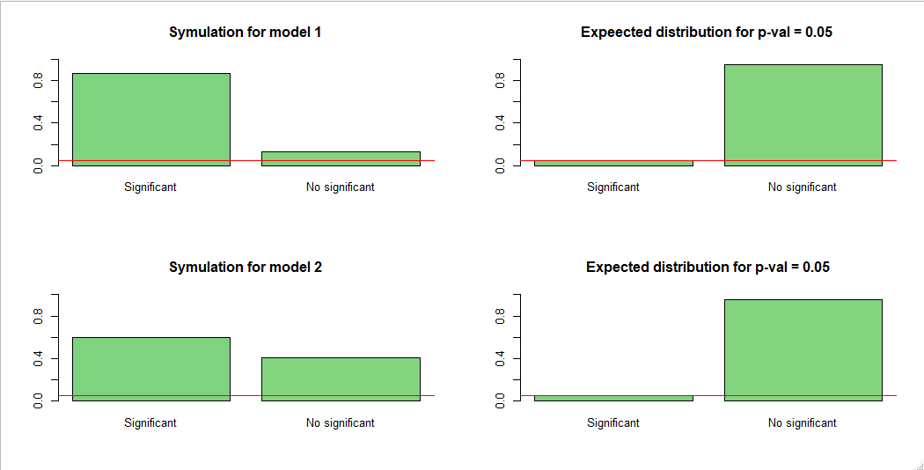
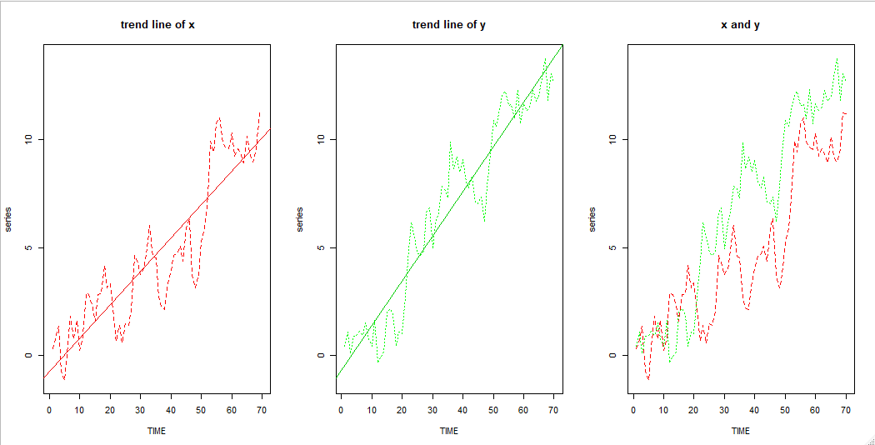
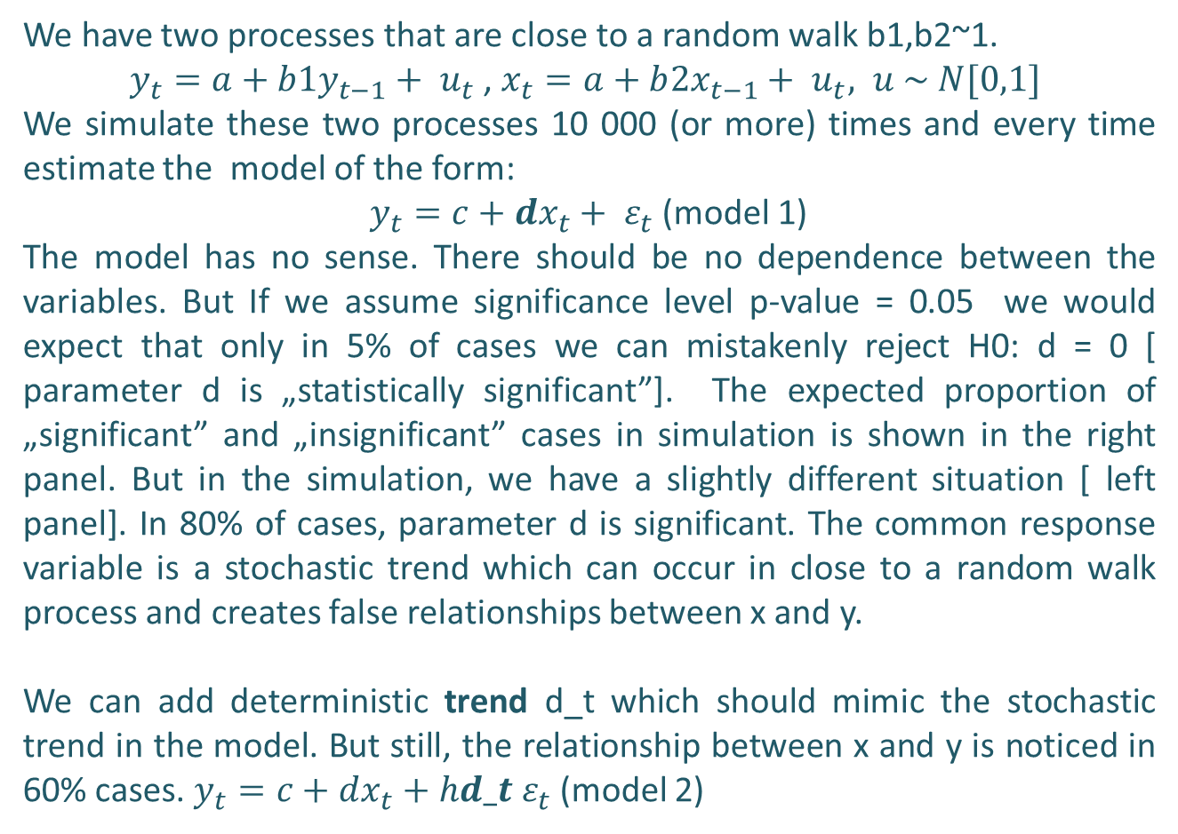
Spurious regressions (replicaton of MC study)
Granger and Newbold (1974)
We have two processes that are close to a random walk b1,b2~1.
$y_{t}=a+b1y_{t−1}+ u_{t}$, $x_{t}=a+b{2x}_{t−1}+ u_{t}, u \sim N[0,1]$
We simulate these two processes 10 000 (or more) times and every time estimate the model of the form:
$y_{t}=c+dx_{t}+ ε_{t}$ (model 1)
The model has no sense. There should be no dependence between the variables. But If we assume significance level p-value = 0.05 we would expect that only in 5% of cases we can mistakenly reject H0: d = 0 [ parameter d is „statistically significant”]. The expected proportion of „significant” and „insignificant” cases in simulation is shown in the right panel. But in the simulation, we have a slightly different situation [ left panel]. In 80% of cases, parameter d is significant. The common response variable is a stochastic trend which can occur in close to a random walk process and creates false relationships between x and y.
We can add deterministic trend d_t which should mimic the stochastic trend in the model. But still, the relationship between x and y is noticed in 60% cases. $y_{t}=c+dx_{t}+hd_t ε_{t}$ (model 2)

Slide 64
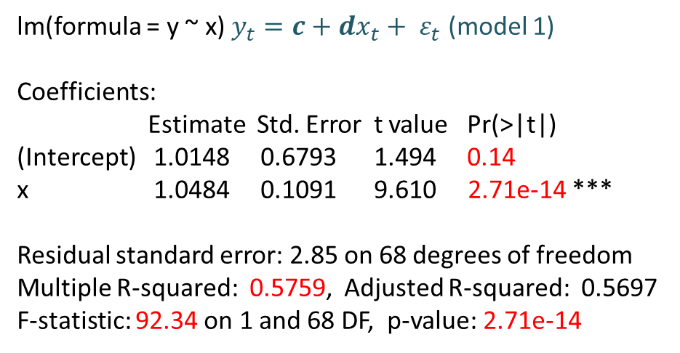
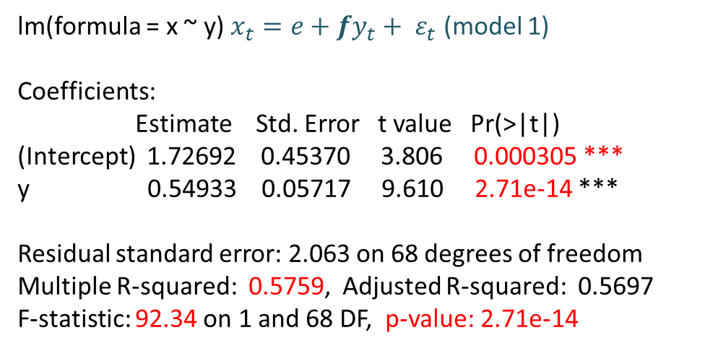
Spurious regressions (replicaton of MC study)
Granger and Newbold (1974)
By the way, econometric models where x or y are dependent variables are equally good based on statistical inference (model 1 and model 3). There is no basis to say whether the causal relationship is x -> y (x is the cause of y) or causal relations is in the opposite direction y -> x (y is the cause of x) or there if the feedback y ↔ x.
lm(formula = y ~ x) $y_{t}=c+dx_{t}+ ε_{t}$ (model 1)
Coefficients:
Estimate Std. Error t value Pr(>|t|)
(Intercept) 1.0148 0.6793 1.494 0.14
x 1.0484 0.1091 9.610 2.71e-14 ***
Residual standard error: 2.85 on 68 degrees of freedom
Multiple R-squared: 0.5759, Adjusted R-squared: 0.5697
F-statistic: 92.34 on 1 and 68 DF, p-value: 2.71e-14
lm(formula = x ~ y) $x_{t}=e+fy_{t}+ ε_{t}$ (model 1)
Coefficients:
Estimate Std. Error t value Pr(>|t|)
(Intercept) 1.72692 0.45370 3.806 0.000305 ***
y 0.54933 0.05717 9.610 2.71e-14 ***
Residual standard error: 2.063 on 68 degrees of freedom
Multiple R-squared: 0.5759, Adjusted R-squared: 0.5697
F-statistic: 92.34 on 1 and 68 DF, p-value: 2.71e-14
Run spurious_regression.R script and experiment. In code, you find some hints on how to deal with R.

Slide 65
A pure coincidence
Sometime there is a pure coincidence.
David Leinweber and Dave Krider found that butter production in Bangladesh had the tightest correlation to the S&P 500 of any data series they could find. It wasn’t GDP growth…it wasn’t earnings…it was Bangladeshi butter, which “explained” 99% of the S&P 500’s movements.
The authors weren’t quacks. They knew the correlation was a random coincidence and completely meaningless. But they published the paper to get a good laugh and to make an important point about number crunching. Correlation does not mean causation, and if your model doesn’t make intuitive sense, it’s probably bogus.
Which of the spurious-correlations [https://tylervigen.com/spurious-correlations] is coused by common response variable which are pure coincidence? ☺

Slide 66
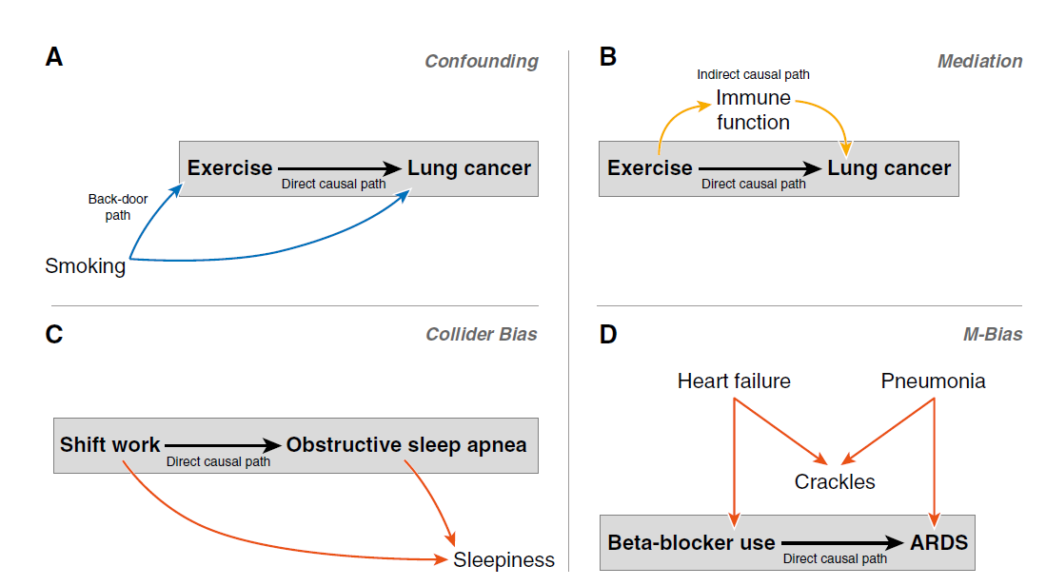
Econometrics and causality
Economics ignored the problem of causality - the causal relationships were determined by a theoretical model. After the appearance of big data, the problem of causality is a hot topic in quantitative research in economics.
Read: https://www.atsjournals.org/doi/full/10.1513/AnnalsATS.201808-564PS

Slide 67
Big data and the causal inference
Researchers don't care about the causality structure when they use machine learning method (or more sophisticated time series models). They focus on the forecast quality. Causality relationships are hidden in the black box of algorithms. But when we have big data sets, we can conduct computational experiments and obtain the causal-effect relationships.
Natural and non-planned experiments; the big data includes the information about results of them we have to find tools how to mine it. (my new category)
If your firm is really big and generates and collects a lot of data you will be able to create your experimental study, like Facebook does for years.
(https://www.pnas.org/content/111/24/8788.full)
Without a formal experimental study, you can create a computational experiment based on big data and economic tools such as instrumental variables regression, discontinuity and differences-in-difference models. You can analyse a lot of natural experiments which are hidden in the big data sets. See the article by Varian (Google).
https://www.pnas.org/content/113/27/7310

Slide 68
My speculation (old slide)
A new generation research method will be a combination of econometrics, data science, experimental methods and simulation. The tool should be able to find the causal structure and generate good forecasts.
Whoever discovers this type of method will break the bank :)
But maybe society is such a complex and evolutionary system that there is no possibility to find that type of model. Your goal is to face this challenge.

Slide 69
Proof of that I'm right
The Nobel prices for Joshua D. Angrist and Guido W. Imbens
“for their methodological contributions to the analysis of causal relationships”
But it is the beginning …
If you would like to redefine your econometric knowledge please visit the page:
http://www.mostlyharmlesseconometrics.com/

Slide 70
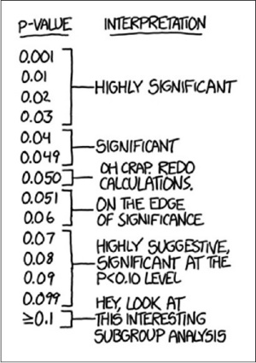
Do not join P-value cult
The enormous publishing pressure causes researchers to manipulate the p-vale value to show that they have successfully confirmed the existence of a theoretical or expected (by them) relationship. Sometimes it is plain fraud*, sometimes data manipulation, and sometimes the routine usage of the p-value.
Do not be a part of the p-value cult.
*Sad story: Dan Ariely ( a media star of behavioural science) research the scientific fraud and recently he was caught cheating.
https://www.science.org/content/article/fraudulent-data-set-raise-questions-about-superstar-honesty-researcher
https://www.ncbi.nlm.nih.gov/pmc/articles/PMC5187603/

Slide 71
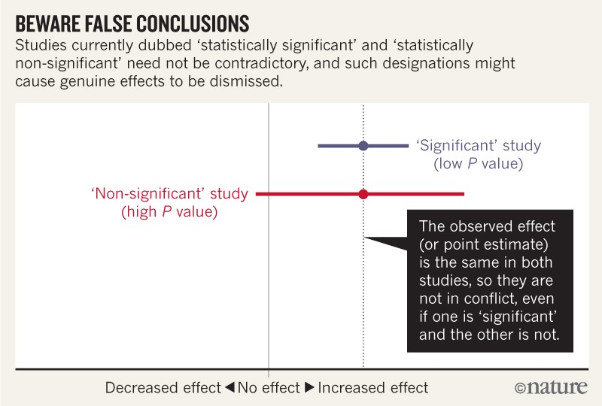
Do not join P-value cult
In statistical reserch, passing the magic border [p-value < 0.05] was considered equivalent to proving the "statistical significance". This is not true. The procedure, which regards randomness, cannot give us a sure and unambiguous result [is/is not]. After years of the routine implementing the false schema, the revolution is coming which will ban "statistical significance" as a routine. Significance test cannot be treated as a final conclusion. We need to go back to a solid statistical analysis of data, and not end up on one test and often misinterpreted. As an introduction, read the article https://www.nature.com/articles/d41586-019-00857-9
(I will test your understanding of p-value next month):
https://www.nature.com/articles/d41586-019-00857-9

Slide 72
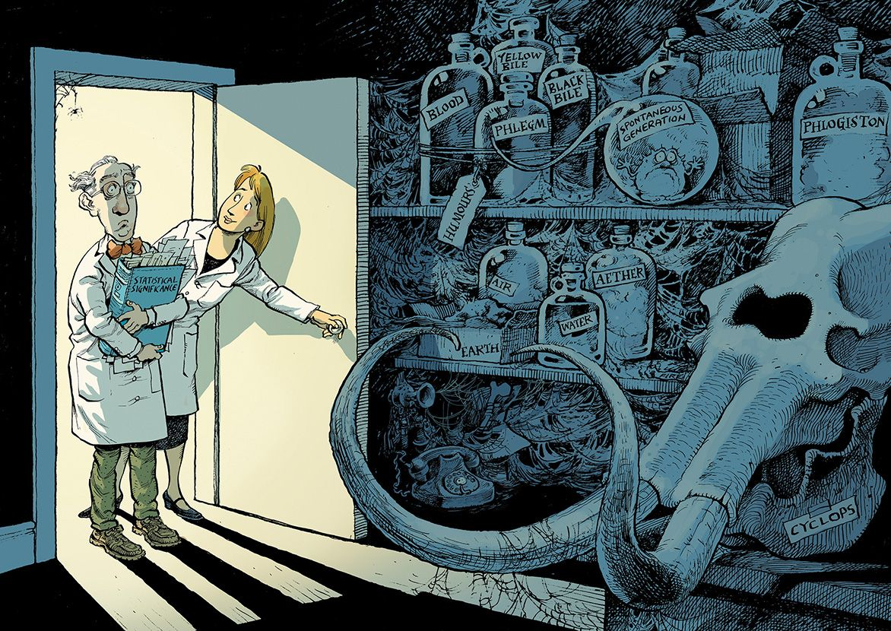

Do not join P-value cult
This type of summary was accepted before:
The difference between the WTP values in the Negative and Positive treatments was statistically significant. In the light of this result, I can conclude that the framing effect had impact on the valuation of the product.
now you can't write as if you are still p-value cult believer. This is one of the tools which you have to use appropriately and you have to use more ststistical tools of to confirm your findings.
https://www.nature.com/articles/d41586-019-00857-9

Slide 73
Is "emotional contagion" experiment ethical?
For one week in January 2012, data scientists skewed what almost 700,000 Facebook users saw when they logged into its service. Some people were shown content with a preponderance of happy and positive words; some were shown content analyzed as sadder than average. And when the week was over, these manipulated users were more likely to post either especially positive or negative words themselves.
… Many previous studies have used Facebook data to examine “emotional contagion,” as this one did. This study is different because, while other studies have observed Facebook user data, this one set out to manipulate it.
The experiment is almost certainly legal. In the company’s current terms of service, Facebook users relinquish the use of their data for “data analysis, testing, [and] research.” Is it ethical, though? Since news of the study first emerged, I’ve seen and heard both privacy advocates and casual users express surprise at the audacity of the experiment. https://medium.com/message/what-does-the-facebook-experiment-teach-us-c858c08e287f

Slide 74
Todo
No lecture report!!! Only Chance to obtain some points on the topic forum.
Read Introduction to Experimental Economics by Nobel Prize winner- https://www.wiwi-experimente.tu-berlin.de/fileadmin/fg210/handbook_3_109.pdf Read a critical paper on experimental economics:
https://www.researchgate.net/publication/248419698_What_Do_Laboratory_Experiments_Tell_Us_About_the_Real_World
Start a discussion about experimental/behavioural economics on the topic forum.
You have to read about causality and p-value issues. It is very important for you. I prepared an ad hoc research to test your understanding of the issues (will be next month):
https://www.nature.com/articles/d41586-019-00857-9
https://www.ncbi.nlm.nih.gov/pmc/articles/PMC5187603/
https://www.atsjournals.org/doi/full/10.1513/AnnalsATS.201808-564PS

